Slide 1

Rate and Entitlements & Shares
Staff Presentation at Annual Shareholders Meeting
April 14, 2026
1

Slide 2

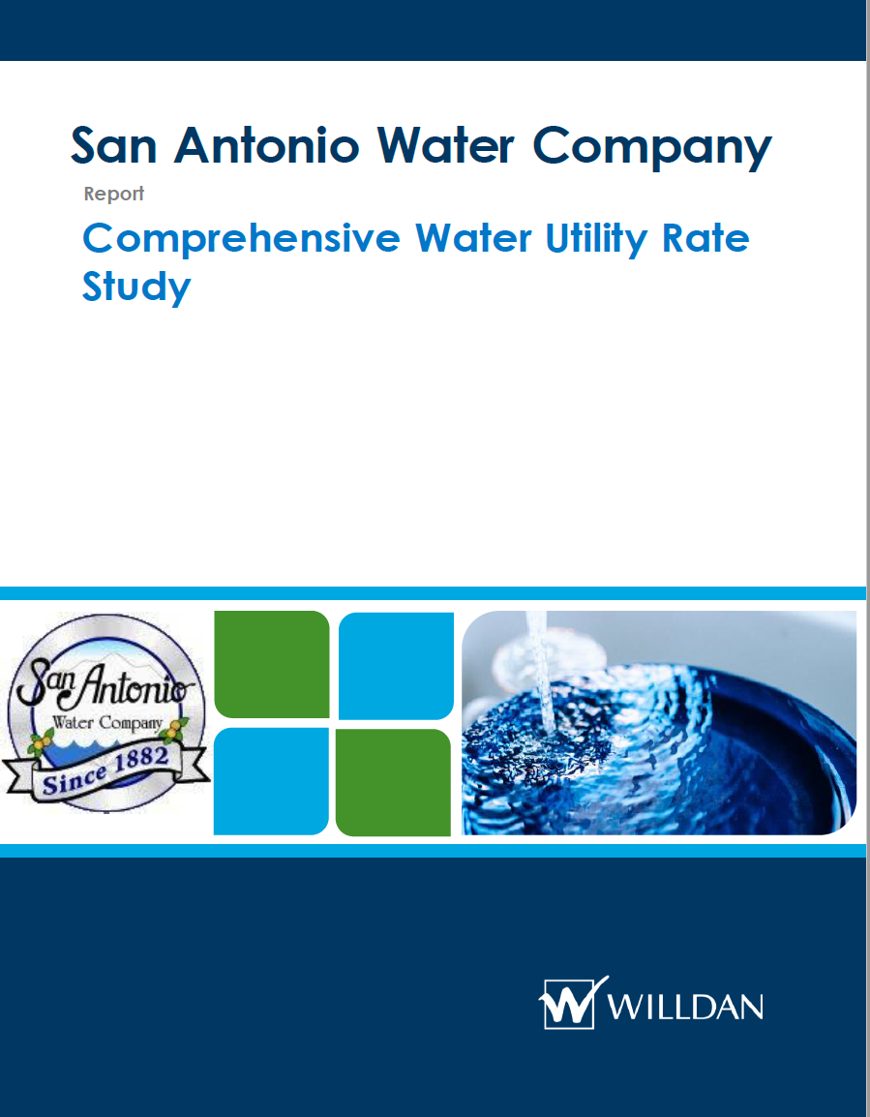
Available Information
blee@sawaterco.com
2

Slide 3
Rates
3

Slide 4
2025 Rate Setting Goals and Issues
Macro-Goal
  Match revenue to expenses while maintaining capital and operating reserves
Micro-Goals
  Increase revenue stability
  Better align Company’s rate structure with industry standards
Last rate review was in 2017 – eight years ago
Inflation increases (specifically in regard to construction costs) in 2021-2024 period
4

Slide 5
New Rates Approved in July 2025 for implementation on January 1, 2026
Description | Prior Rate / Month | 2026 Rate / Month
¾” | $10.00 | $23.14
1.0” | $20.00 | $57.86
1.5” | $40.00 | $115.72
2.0” | $60.00 | $185.16
3.0” | $120.00 | $347.17
4.0” | $150.00 | $578.61
6.0” | $250.00 | $1,157.23
8.0” | $400.00 | $1,851.56
10.0” | $1,000.00 | $2,661.62
12.0” | $1,500.00 | $4,976.07
14.0” | $1,500.00 | $7,406.25
16.0” | $1,500.00 | $10,600.19
Tier 1 | $0.68/unit | $0.59/unit
Tier 2 | $1.78/unit | $2.08/unit
Tier 3 | $3.78/unit | $3.20/unit
5

Slide 6
Water Utility Bill Comparison @ 3,650 CF (½ Share)
Assumes a 3/4” residential customer receiving 3,650 CF (or ≈ 27,300 gallons) of service per month.
6

Slide 7
Entitlements & Shares
7

Slide 8
Entitlement
For 2025 entitlement was 13,000 AF
Company also spread 2,664 AF in 2025
Average spread for the last five years was ~4,000 AF
Current Company storage is ~17,000 AF in Chino Basin
The Company raised entitlement for 2026 to 15,000 AF
8

Slide 9
15,000 AF Entitlement in 2026
Two types of shareholders: Retail and Wholesale
  There are 933.5 Retail shares and 5,455.5 Wholesale shares
  Based on 2025 consumption the projected 2026 usage of Retail shares is 1,340 AF
  ‘Unused’ 2026 entitlement for Retail Shares is projected to be 852 AF
  Company is proposing to sell the unused retail entitlement to wholesale shareholders for the benefit of the retail shareholders
9

Slide 10
What to do with 852 AF ‘unused’ entitlement for 2026
Offer all shareholders the ‘unused’ 852 AF entitlement at Tier 2 rate through paper-transfer in Chino Basin
Subtracting Tier 1 rate from generated revenue to cover Company costs
Provide remaining revenue from sale of Tier 2 water as a credit for 2027 Retail shareholder water usage
10

Slide 11
Credit for 2027 water usage
Credit would only apply to 2027 water consumption.
Credit would expire at end of 2027
Since credit is based on ‘unused water’, it is reasonable to only apply credit to future water use, not fixed charges.
  Not WAC charge
  Not Readiness to Serve Charge (meter charge)
These two conditions are intended to prevent ‘share-squatters’ and encourage future use of shares.
11

Slide 12
Results
Encourages conservation in the Heights by providing a direct financial benefit
Assists Irrigators in maintaining historical groves
Assists municipal shareholders in reducing imported water demand
Encourages use of shares by providing rebate to future water use
Tier 1 rate is $257.24/AF
If we sell the ‘unused’ 852 AF @ 2x Tier 1 rate ($514.48/AF) the Company would generate $438,000 of revenue
Subtracting the Tier 1 Rate for Company’s costs would leave $219,000 for future water usage credit
Dividing $219,000 amongst the 933.50 retail shares provides a future water usage credit of $234 per retail share
  At an estimated 1,300 AF of usage per year, for 2026 the Height’s average water cost per share is $521
12

Slide 13
Future?
Company has long term plans (5 years +) to maximize water rights with the intention of raising Companywide entitlement from current 15,000 AF to 19,000 AF.
Continue to sell unused retail entitlement to wholesale shareholders and credit back to retail shareholders.
Lots of moving parts to this plan. Happy to discuss details with anyone.
13

Slide 14

2026 Annual shareholder’s meeting
Thank You!
Please reach out with any questions or concerns
  blee@sawaterco.com
  909.982.4107
14
April 14, 2026

